Slide 1
Drink&Delight
Inventory Management System
V. Satya Devi
186933

Slide 2
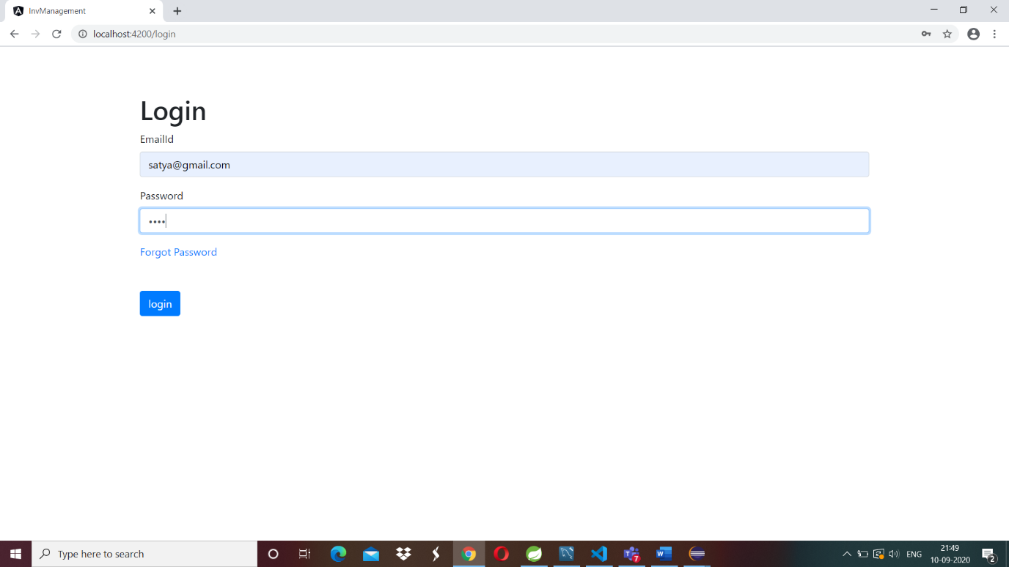
1 Login Functionality
1.1 Login with correct Credentials
Checks credentials present in database
If credentials are correct navigate to welcome page
If credentials are not correct shows pop up as invalid
credentials
Forgot password will navigate to other page

Slide 3
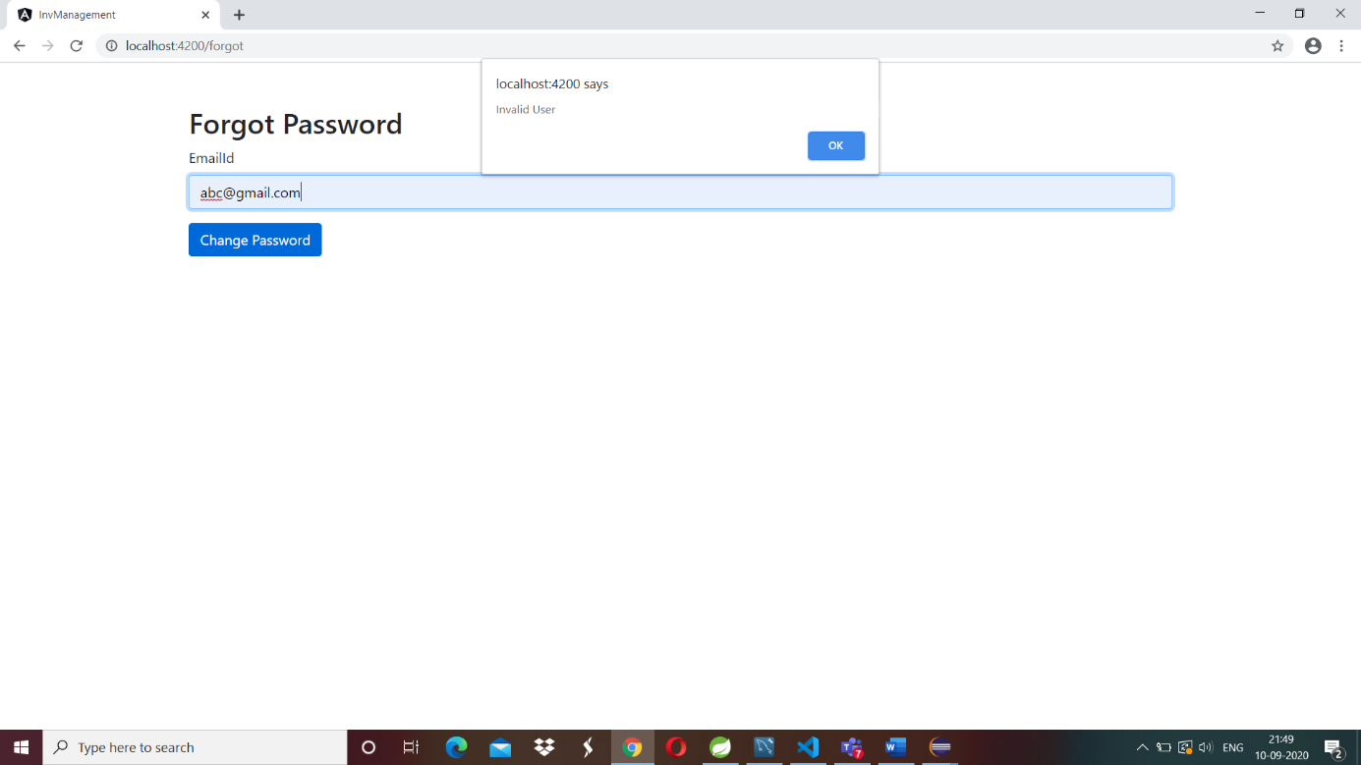
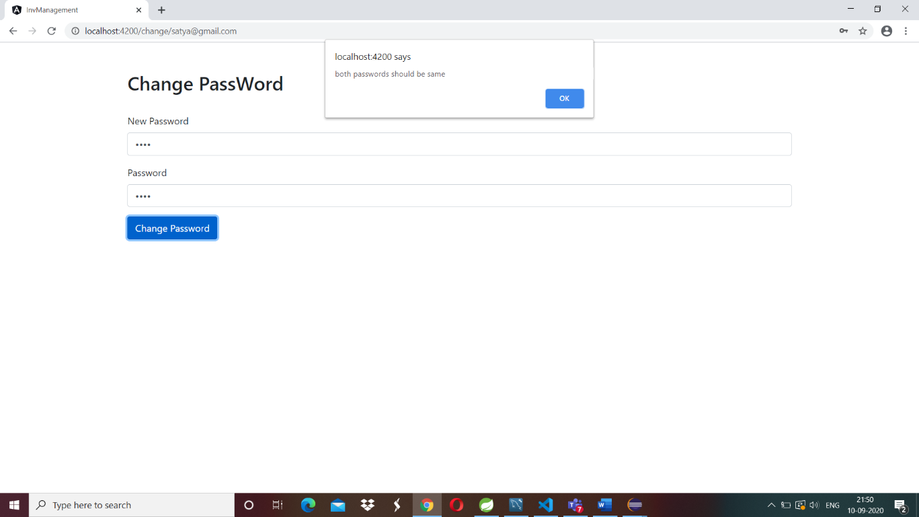
1.2 Forgot Password

Slide 4
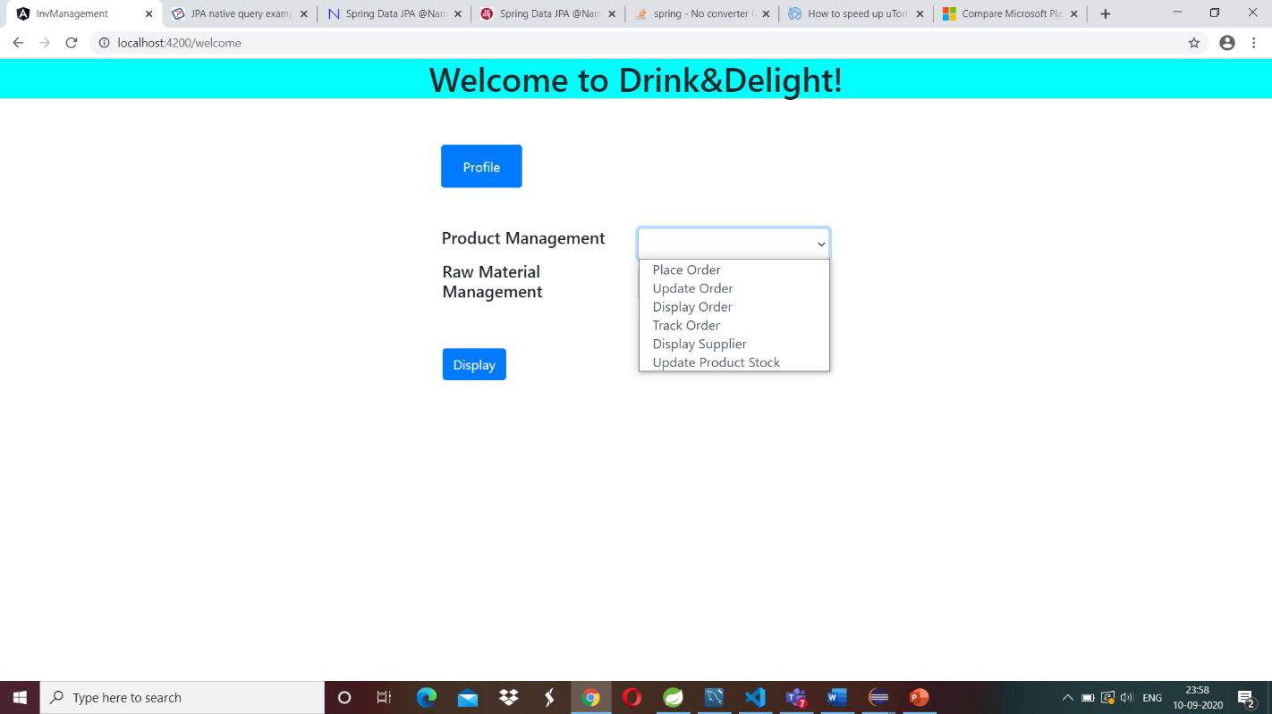
2.Welcome Page
Profile button to show logged in Employee details
Project management drop down to perform different functionalities
Display button to navigate to functionality pages

Slide 5
3.Product Management
3.1 Place Product Order
3.2 Update Product Order
3.3 Display Product Order
3.4 Track Product Order
3.5 Display Supplier
3.6 Update Product Stock
3.6.1 Set Exit Date
3.6.2 Update manufacturing Date, Expiry Date and QV

Slide 6
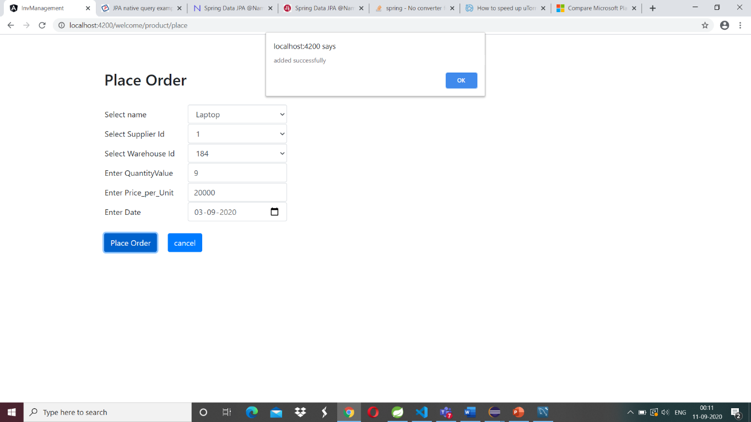
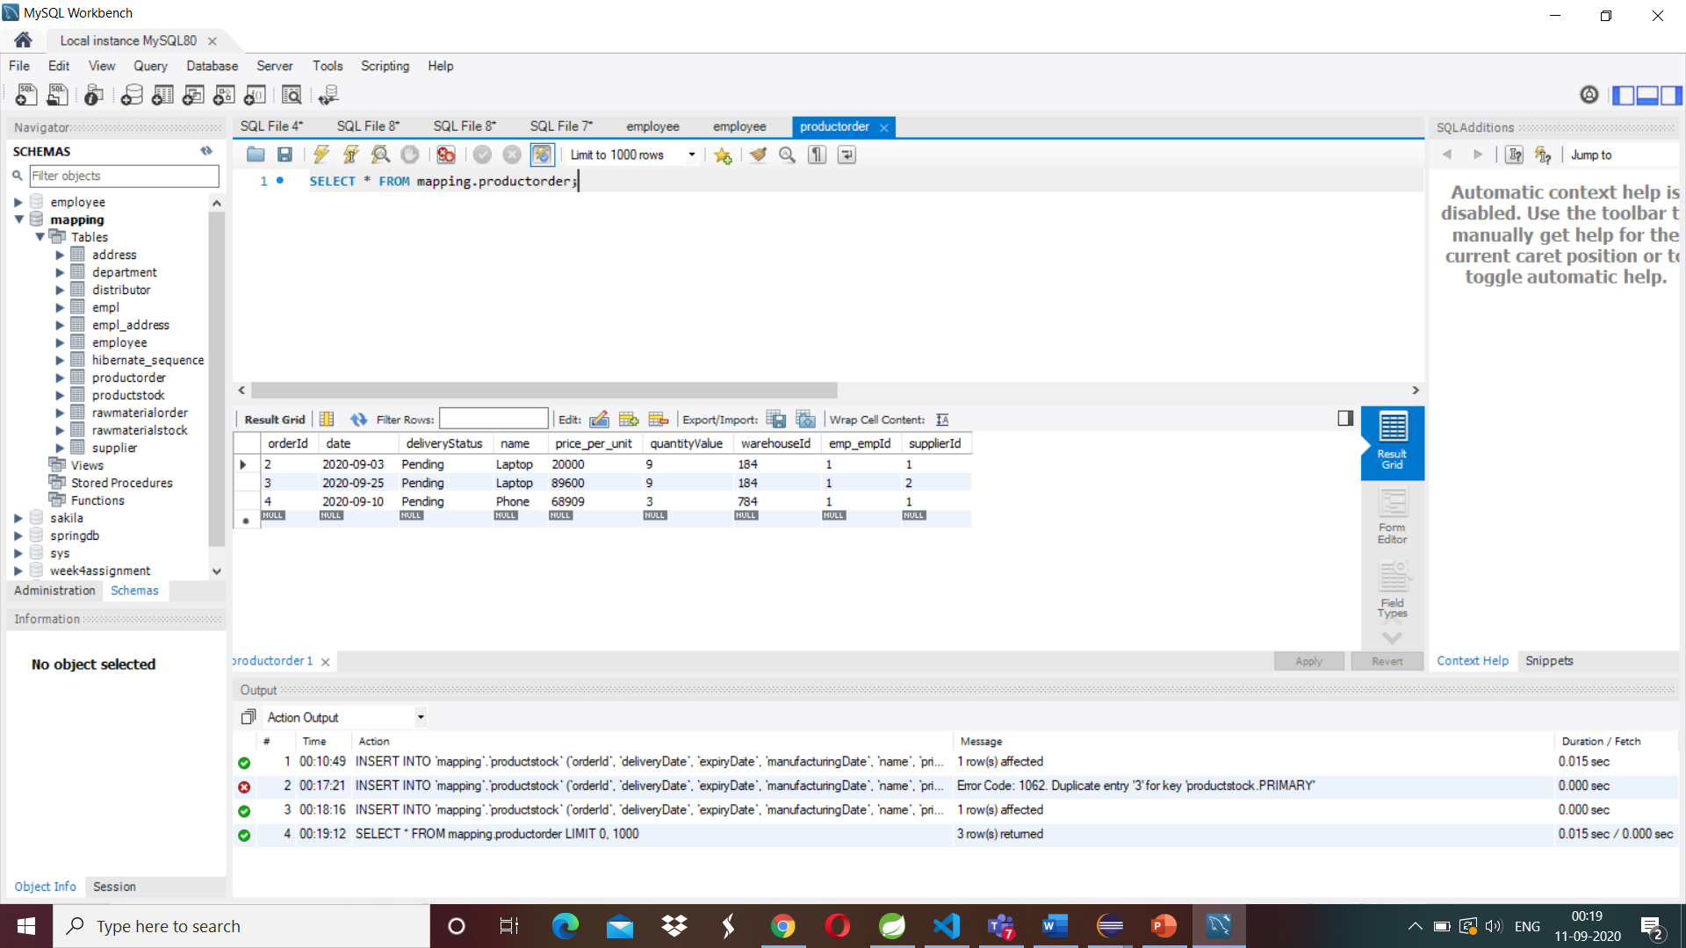
3.1 Place Product Order
Name, Supplier Id, Warehouse Id are fetching
from Product Stock table
When all values got entered then place order
button will enabled
With correct values product Order will be placed

Slide 7
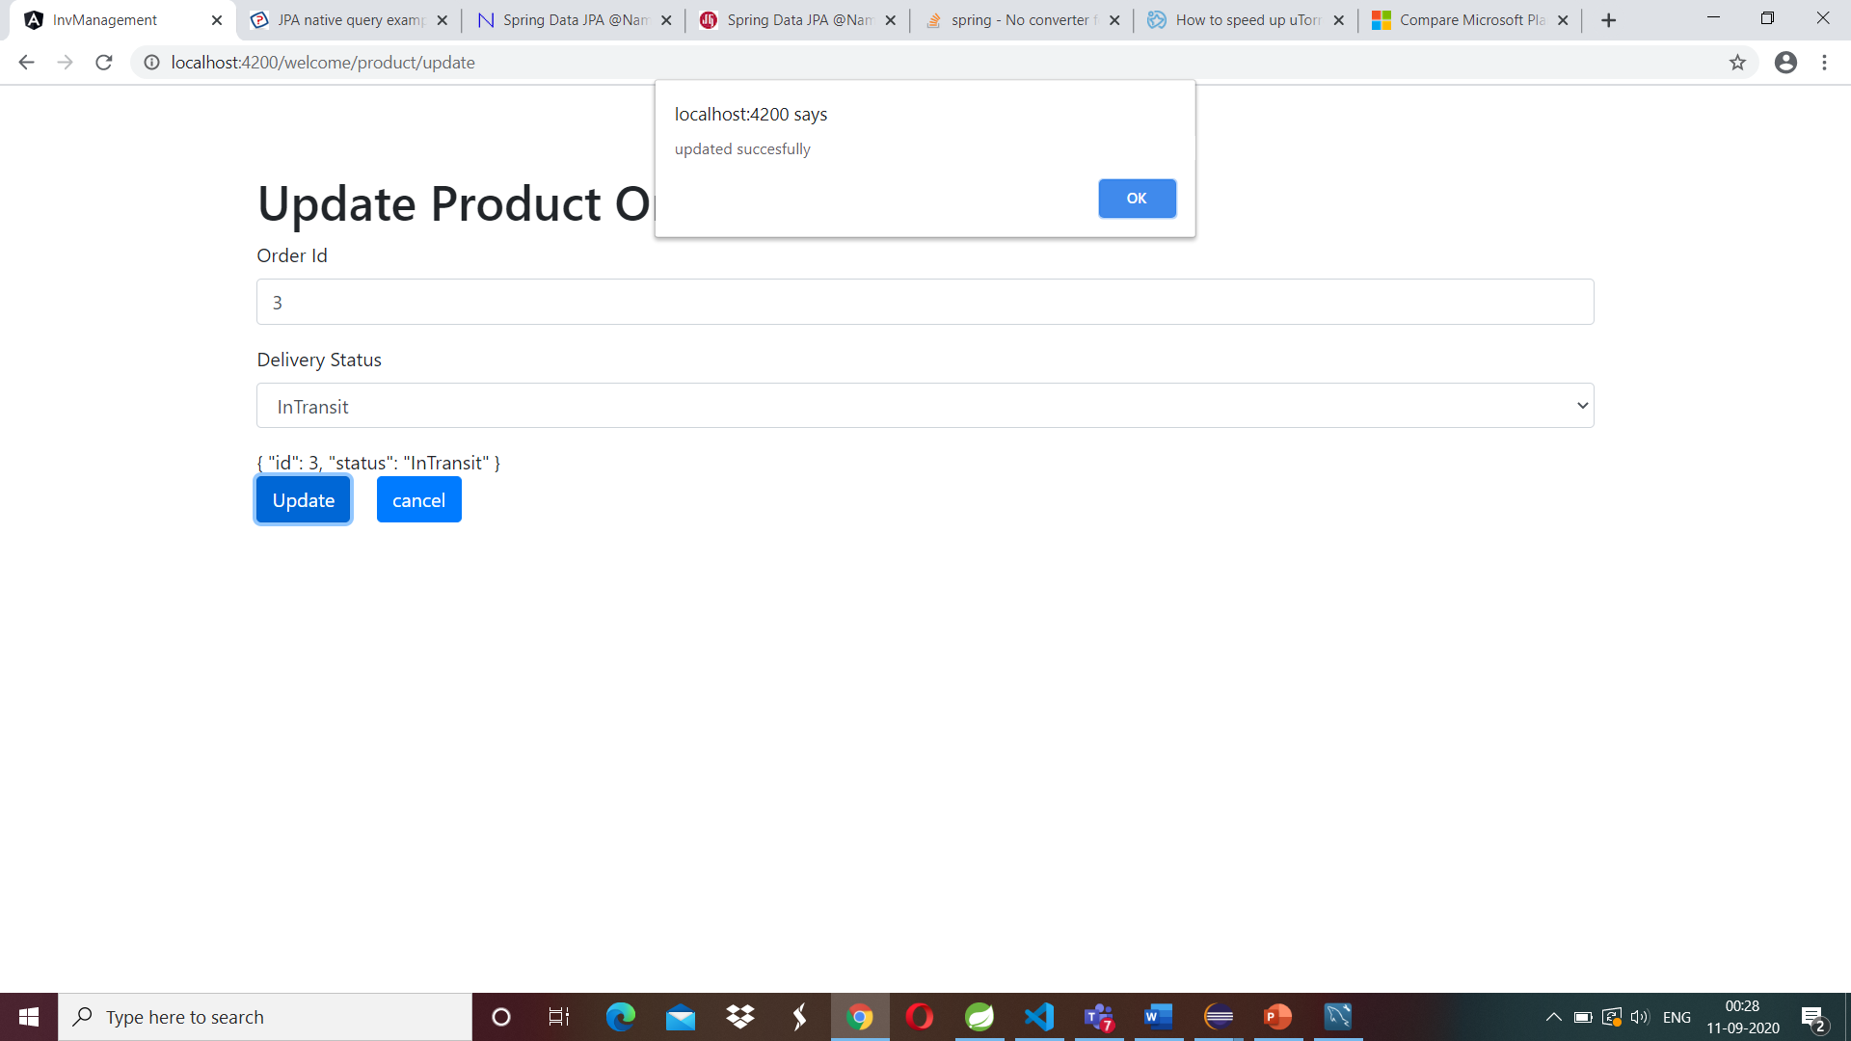
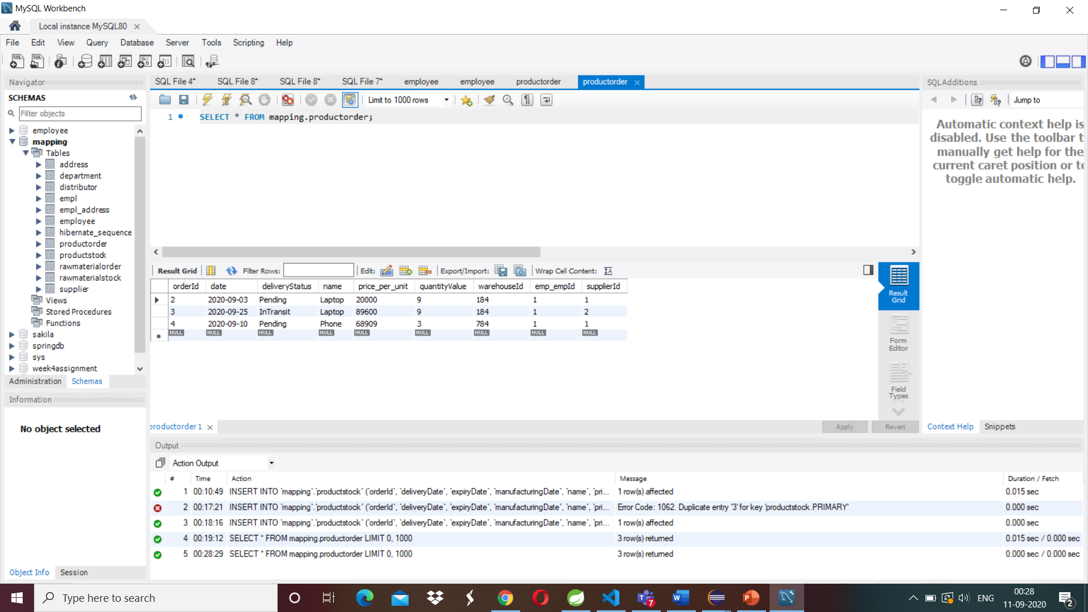
3.2 Update Product Order
Update delivery status of product order
Incorrect order Id will throw popup message
With correct order Id, delivery status will be
updated

Slide 8
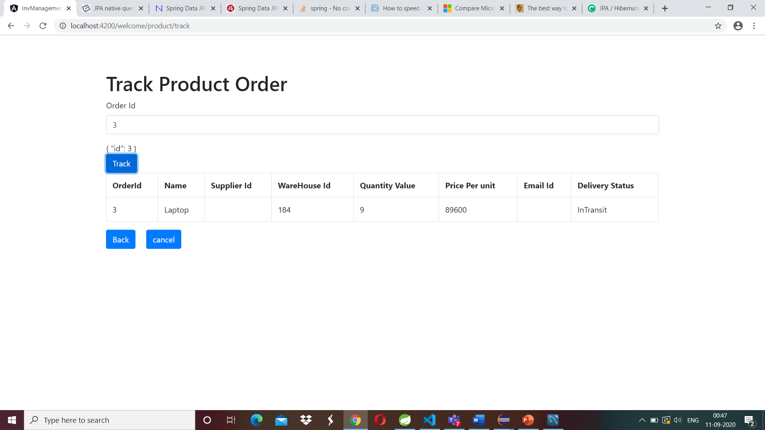
3.3 Track Product Order
When given correct order Id, order details are shown.
With wrong Id, a popup message
as Invalid order id.

Slide 9
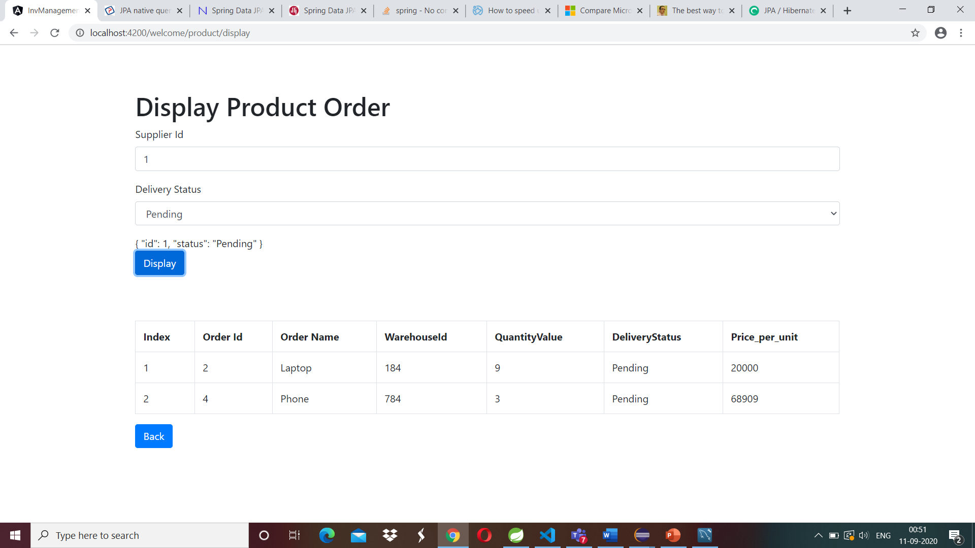
3.4 Display Product Order
Shows product order with respective Supplier Id and delivery Status
If products are not present with supplier Id and Delivery status, no data will be in table.

Slide 10
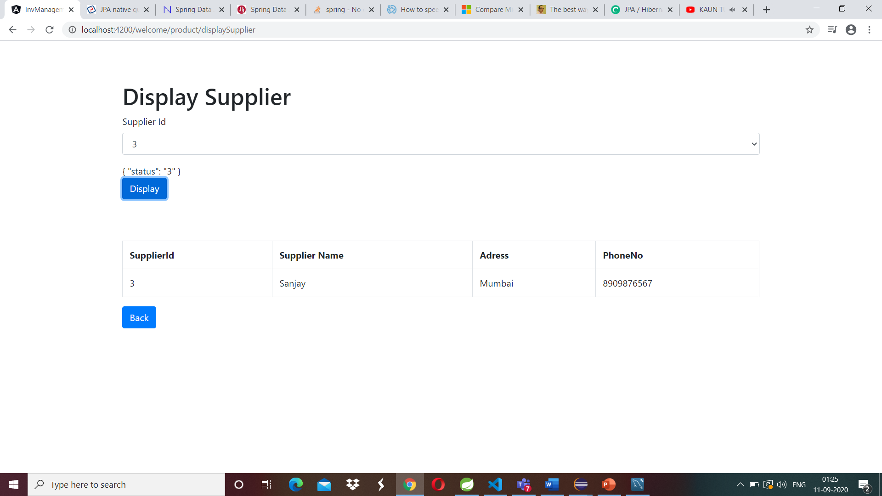
3.5 Display Supplier Details
By selecting supplier Id from supplier id drop
down list ,supplier details will get fetched
from data base.

Slide 11
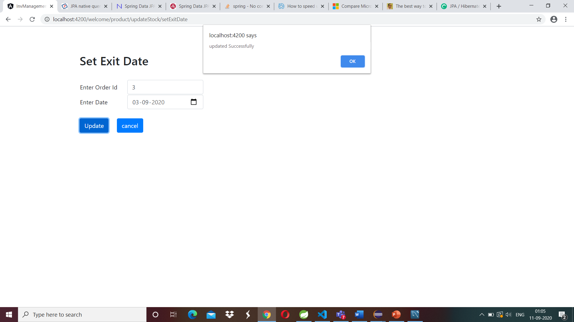
3.6 Update Product Details
3.6.1 Set exit date-
With correct order Id, exit date is updated in
database
With wrong id ,Popup message will get
generated

Slide 12
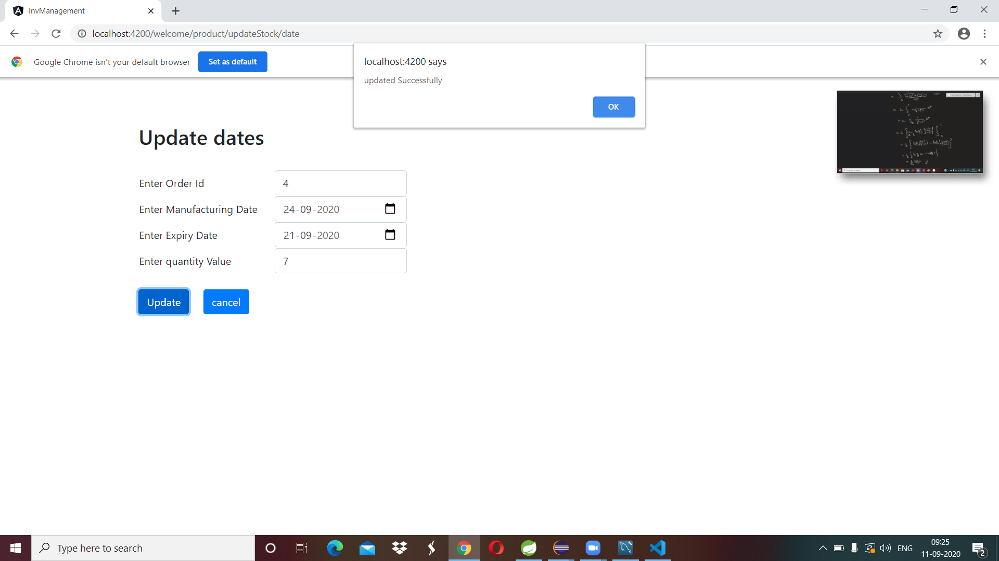
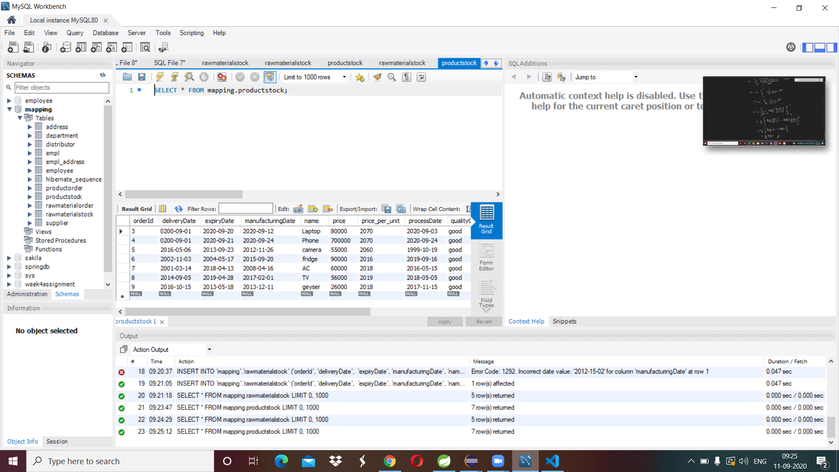
3.6.1 Update Manufacturing date, Expiry date & QV Date-
This functionality updates the manufacturing date ,
Expiry date and quantity value of product stock
with correct Order Id.
Wrong order Id will give popup message

Slide 13
4. Raw Material Management
4.1 Raw Material Order
4.2 Update Raw Material Order
4.3 Display Raw Material Order
4.4 Track Raw Material Order
4.5 Display Distributor
4.6 Update Raw Material Stock
4.6.1 Set Exit Date
4.6.2 Update manufacturing Date, Expiry Date and QV

Slide 14
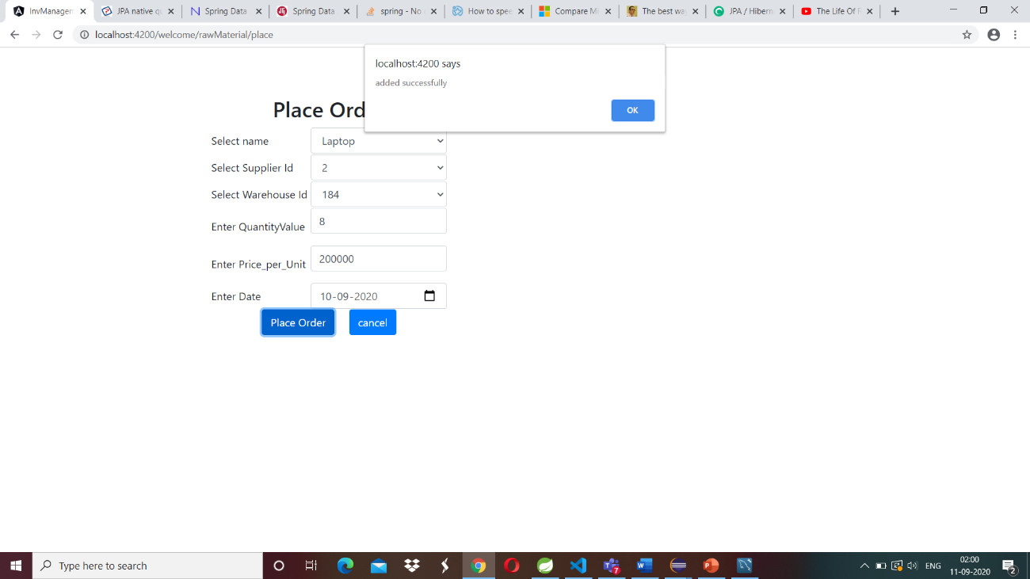
4.1 Place Raw Material Order
Name, Supplier Id, Warehouse Id are fetching
from raw material Stock table
When all values got entered then place order
button will be enabled
With correct values product Order will be placed

Slide 15

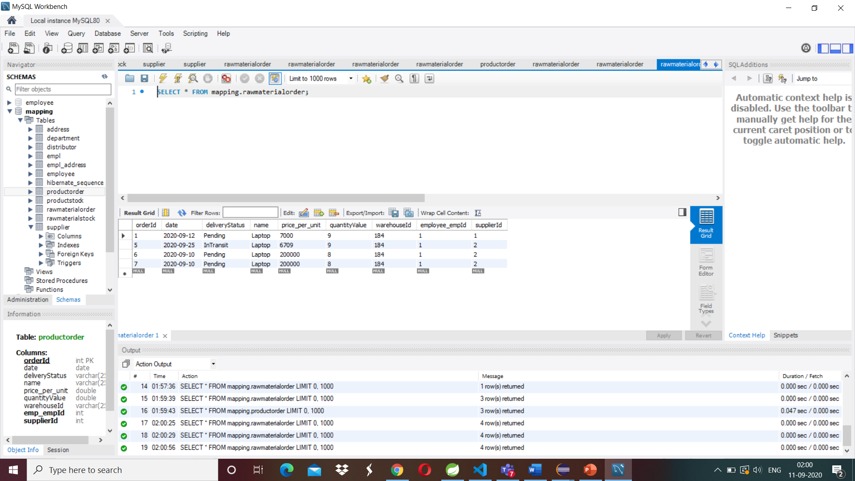
4.2 Update Raw Material Order
Update delivery status of raw material order
Incorrect order Id will throw popup message
With correct order Id delivery status will be
updated

Slide 16
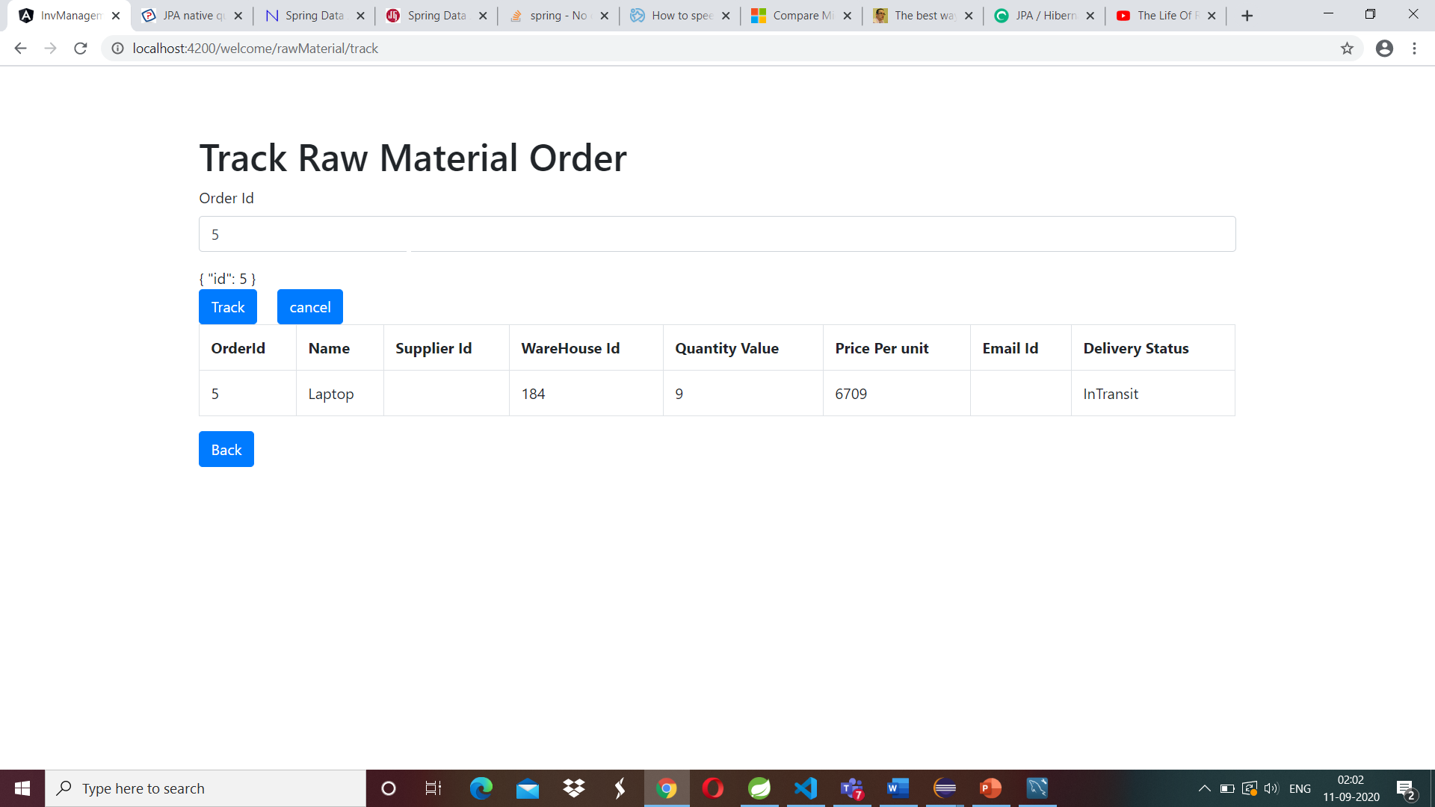
4.3 Track Raw Material Order
When given correct order Id, order details are shown.
With wrong Id, will get popup message
as Invalid order id.

Slide 17
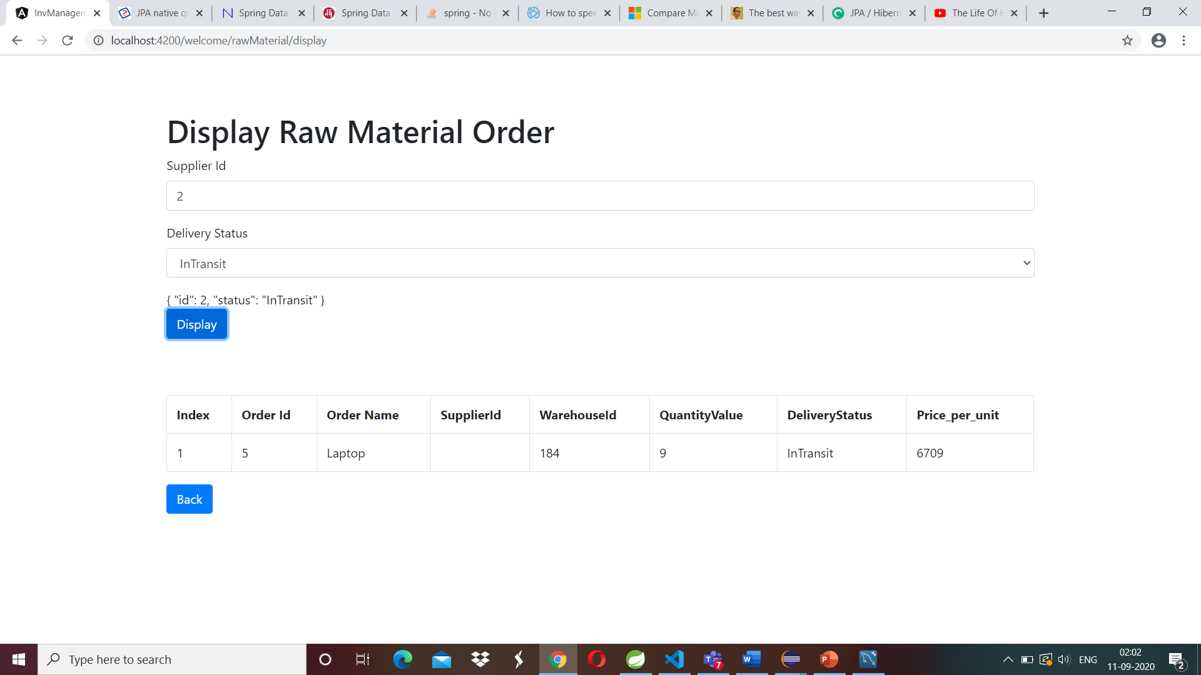
4.4 Display Raw material Order
Shows Raw material order with respective Supplier Id and delivery Status
If product are not present with supplier Id and Delivery status

Slide 18
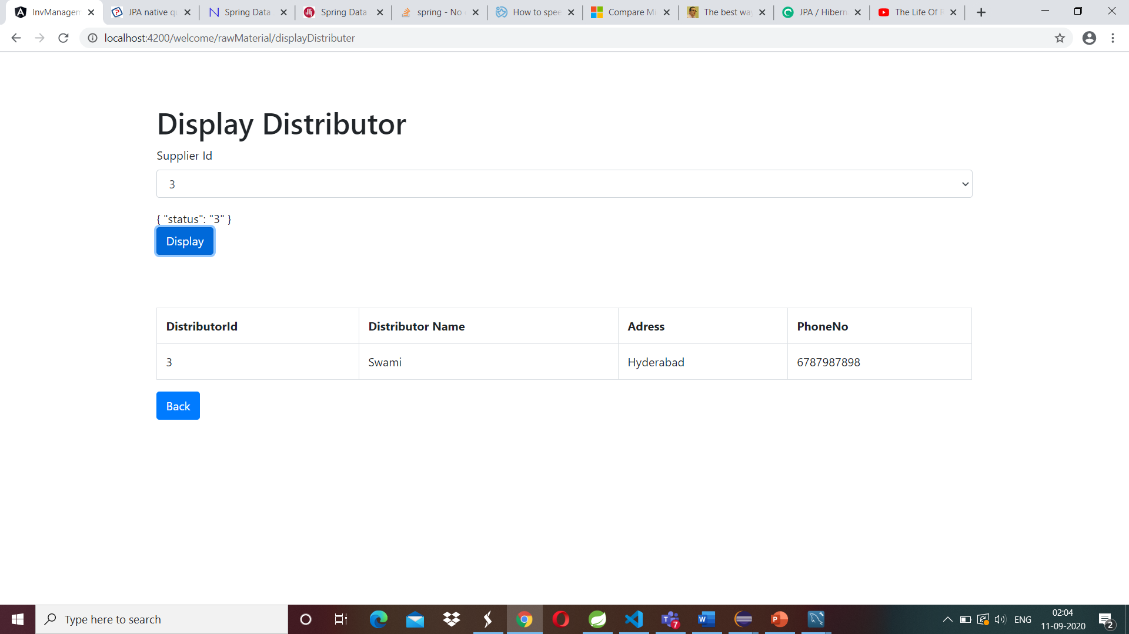
4.5 Display Distributor Details
By selecting distributor Id from distributor id drop
down list ,distributor details will get fetched
from data base.

Slide 19
4.6 Update Raw material Details
4.6.1 Set exit date-
With correct order Id, exit date is updated in
database
With wrong id ,Popup message will get
generated stating No Id Present

Slide 20

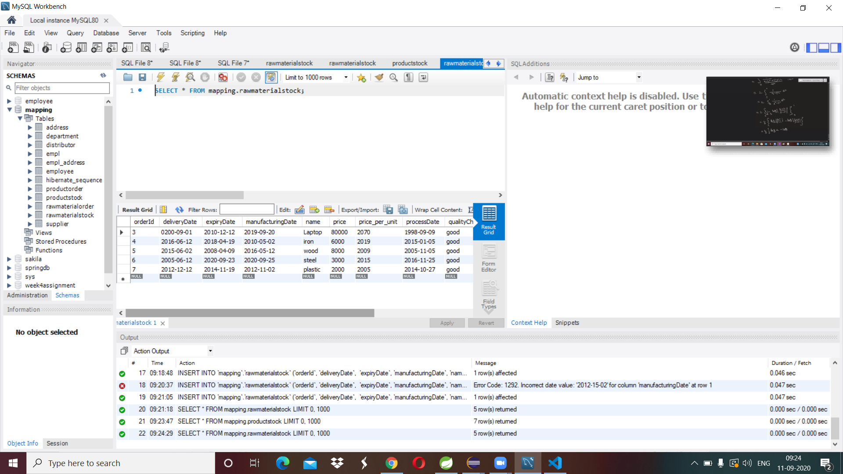
4.6.2 Update Manufacturing date, Expiry date & QV Date-
This functionality updates the manufacturing date ,
Expiry date and quantity value of raw material stock
with correct Order Id.
Wrong order Id will give popup message

Slide 21
Thank You

